Slide 1
Modifying CSS with JS
Modifying an element’s inline style | Modifying Stylesheet | Adding and Removing Classes
Notes:
Welcome to our lecture on modifying CSS with JS. In this lecture we will go through how to modify an element’s inline style, modify stylesheet, and adding and removing classes. Let’s start our lecture.

Slide 2
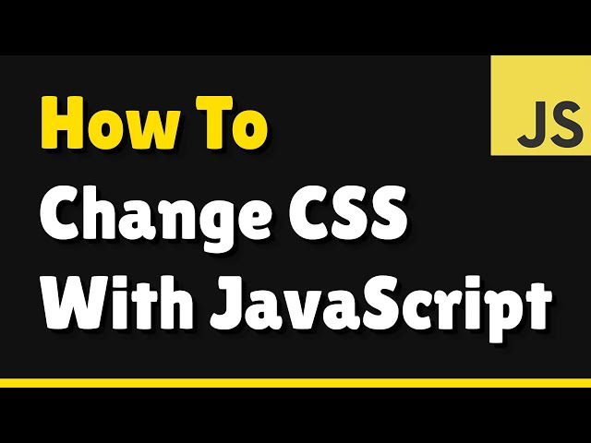
Modifying an element's inline style
Modifying CSS with JavaScript: The CSS Object Model (CSSOM) allows JavaScript to dynamically change an element’s styles.
Accessing Styles: getPropertyValue("color") retrieves a CSS property value, or style.color gets inline styles directly.
Notes:
JavaScript can modify an element's style dynamically using the CSS Object Model or CSSOM. This allows for real-time updates like changing colors, sizes, or visibility. To access styles, get Property Value retrieves computed CSS values, while the style property modifies inline styles directly. These methods help create interactive and visually dynamic web pages by adjusting styles with code.

Slide 3
Modifying an element's inline style
Modifying Styles: setProperty("color", "blue") or style.color = "blue" changes a style, while removeProperty("color") removes it.
Camel Case Conversion: CSS properties with dashes (e.g., background-color) are accessed in JavaScript using camel case (backgroundColor).
Notes:
JavaScript allows modifying inline styles dynamically. The set Property method or directly setting style properties can change an element's appearance, while remove Property removes a style. CSS properties with dashes, like background-color, must be written in camel case as background Color in JavaScript. These techniques help create dynamic and interactive styling in web applications.

Slide 4
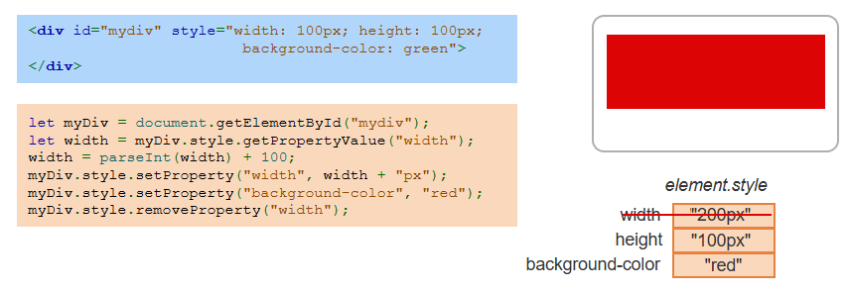
Example
Notes:
This example demonstrates modifying an element's inline styles using JavaScript. The div starts with a width of 100 pixels and a green background. JavaScript retrieves and increases the width by 100 pixels, changes the background color to red, and removes the width property. This shows how styles can be dynamically updated using set Property, get Property Value, and remove Property methods.

Slide 5
Modifying a stylesheet
Accessing Stylesheets: The document.styleSheets object stores all stylesheets on a webpage, each as a CSSStyleSheet object.
Adding Rules: insertRule("p { color: blue; }") adds a new CSS rule to a stylesheet.
Deleting Rules: deleteRule(0) removes a CSS rule at the specified index from a stylesheet.
Notes:
JavaScript allows modifying stylesheets dynamically. The document dot style Sheets object provides access to all stylesheets on a page. Using insert Rule, we can add new CSS rules to modify styles, while delete Rule removes specific rules from a stylesheet. This approach is useful for updating styles without altering the original CSS file, enabling dynamic styling in web applications.

Slide 6
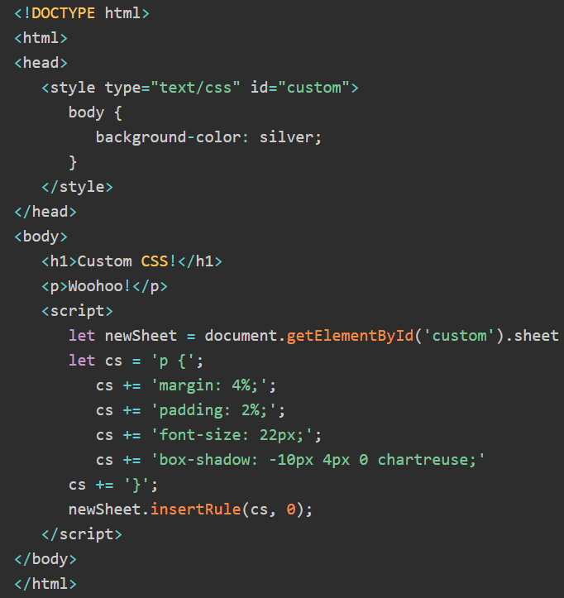
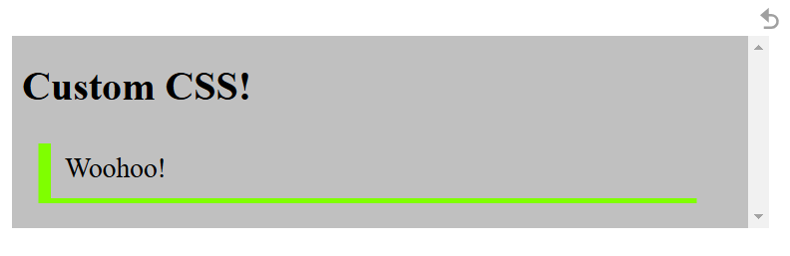
Insert Rule Example
Notes:
This example shows how to dynamically insert CSS rules using JavaScript. The webpage starts with a silver background, and JavaScript selects the stylesheet to add new styles for the paragraph element. The insert Rule method applies properties like margin, padding, font size, and a box shadow. This technique is useful for modifying styles dynamically without changing the original CSS file.

Slide 7
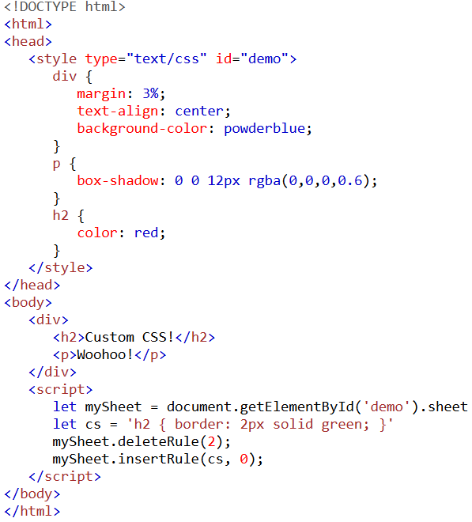

Delete Rule Example
Notes:
This example demonstrates how to delete and add CSS rules dynamically using JavaScript. The stylesheet initially contains styles for headings, paragraphs, and DIVS. The delete Rule method removes the existing h2 rule, which originally set the text color to red. Then, insert Rule adds a new style, giving h2 a green border. This technique helps in updating styles dynamically without modifying the CSS file.

Slide 8
Adding and removing classes
Best Practice: Use CSS classes for styling and JavaScript to add/remove classes instead of modifying styles directly.
Managing Classes: The classList property stores all classes assigned to an element.
Methods:
add("class") → Adds a class.
remove("class") → Removes a class.
toggle("class") → Toggles a class on/off.
Notes:
Using CSS classes is the best practice for styling elements, and JavaScript provides methods to manage them dynamically. The class List property stores all classes applied to an element. We can use add to apply a new class, remove to delete a class, and toggle to switch a class on or off. These methods allow dynamic styling without modifying inline styles, making code more efficient and manageable.

Slide 9

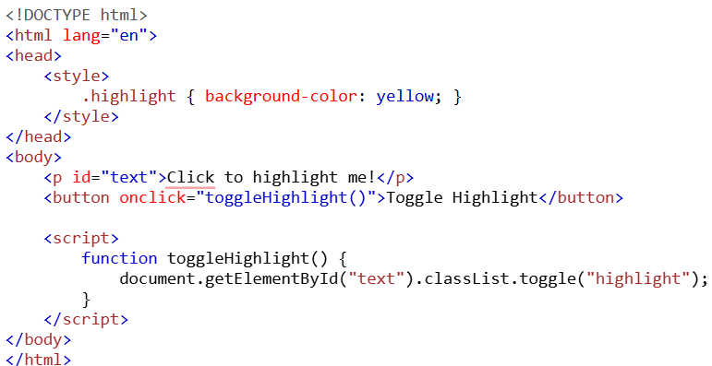

Example
Notes:
This example demonstrates adding and removing classes dynamically using JavaScript. The paragraph starts with no background color. When the button is clicked, the toggle method adds or removes the highlight class, which applies a yellow background. This technique allows interactive styling without modifying inline styles directly, making it a flexible and efficient way to update element appearance. Thanks for watching the lecture.

